Slide 1
Electric Charge and
Electric Fields
Session 1
SCIE6063
COMPUTATIONAL PHYSICS
June 2024

Slide 2
Electric Charge
Electric charge is the physical property of matter that causes it to experience a force when placed in an electromagnetic field
Two types of electric charge:
The electric charge of a body due to missing or extra electron
  The body have positive charge if miss electron
  → Glass rubbed with silk
  The body have negative charge if extra electron
    Rubber/ Plastic rubbed with fur
Units of charge is measured in Coulombs (abbreviated C)
Empirical Observations:
Like charges repel
Unlike charges attract

Slide 3
Charge Properties
Electric Charge
Conservation
  Charge is not created or destroyed, only transferred.
  The net amount of electric charge produced in any process is zero.
Quantization
  The smallest unit of charge is that on an electron or proton. (e = 1.6 x 10⁻¹⁹ C)
    It is impossible to have less charge than this
    It is possible to have integer multiples of this charge, q = ne n = ±1, ±2, ±3, ……….

Slide 4
Electric Charge
Table 1. The Charges of Three Particles
Particle | Symbol | Charge
Electron | e or e⁻ | -e
Proton | P | +e
Neutron | n | 0
Charge is a property of particles, one of many properties, such as mass.

Slide 5
Conductors and Insulators
Conductors are materials through which charge can move freely; examples include metals (such as copper in common lamp wire), the human body, and tap water.
Nonconductors, also called insulators are materials through which charge cannot move freely; examples include rubber, plastic, glass, and chemically pure water.
Semiconductors are materials that are intermediate between conductors and insulators; examples include silicon and germanium in computer chips.
Superconductors are materials that are perfect conductors, allowing charge to move without any hindrance.

Slide 6
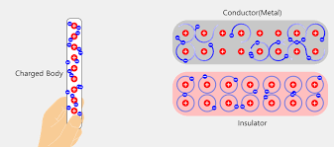
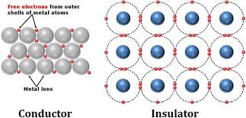
Conductors and Insulators
The properties of conductors and insulators are due to the structure and electrical nature of atoms
Atoms consist of positively charged protons, negatively charged electrons, and electrically neutral neutrons.
The protons and neutrons are packed tightly together in a central nucleus.
There are few (if any) free electrons in a nonconductor.

Slide 7
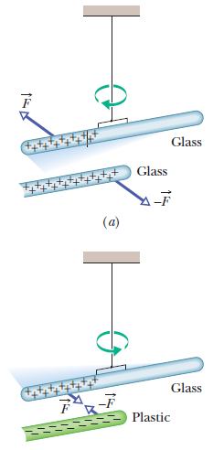
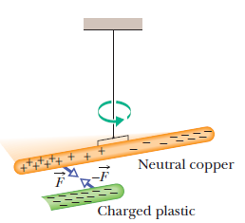
Electric charge & Induced Charge
When atoms of a conductor come together to form the solid, some of their outermost (and so most loosely held) electrons become free to wander about within the solid, leaving behind positively charged atoms ( positive ions).We call the mobile electrons conduction electrons.

Slide 8

Coulomb’s Law
This force of repulsion or attraction due to the charge properties of objects is called an electrostatic force.
The equation giving the force for charged particles is called Coulomb’s law:
where particle 1 has charge q₁ and particle 2 has charge q₂, and F is the force on particle 1.

Slide 9

Coulomb’s Law

Slide 10
Coulomb’s Law
(a)
The forces push the particles apart
(b)
Here too
(C)
But here the forces pull the particles together
Fig.1. Two charged particles repel each other if they have the same sign of charge, either (a) both positive or (b) both negative (c) They attract each other if they have opposite signs of charge

Slide 11
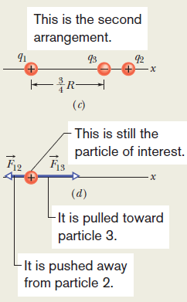
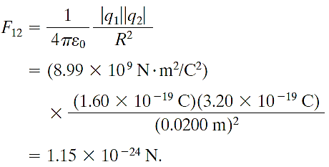
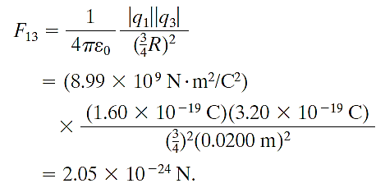
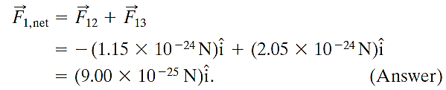
The charges are q1 = 1.60x10⁻¹⁹ C and q2 = 3.20x10⁻¹⁹ C, and the particle separation is R = 0.0200 m. Particle 3
has charge q3 = -3.20x10⁻¹⁹ C and is at a distance from ¾ R from Particle 1.
What is the net electrostatic force on particle 1 due to particles 2 and 3 ?

Slide 12
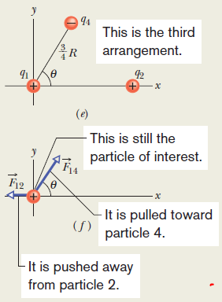
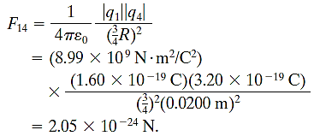





The charges are q1 = 1.60x10⁻¹⁹ C and q2 = 3.20x10⁻¹⁹ C, and the particle separation is R = 0.0200 m. Particle 4
has charge q4 = -3.20x10⁻¹⁹ C and is at a distance from ¾ R from Particle 1 and lies on a line that makes an
an angle u = 60⁰ with the x axis. What is the net electrostatic force on particle 1 due to particles 2 and 3 ?
we add 180º, to correct θ

Slide 13
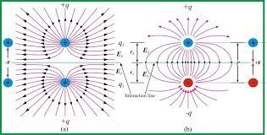

The Electric Fields
The Electric Field is a vector field.
The electric field, E, consists of a distribution of vectors, one for each point in the region around a charged object, such as a charged rod.
We can define the electric field at some point near the charged object, such as point P in Fig. 1a, as follows:
A positive test charge q₀, placed at the point will experience an electrostatic force, F.
The electric field at point P due to the charged objects is defined as the electric field, E, at that point:
The SI unit for the electric field is the Newton per coulomb (N/C).

Slide 14
2. Electric Field Lines
At any point, the direction of a straight field line or the direction of the tangent to a curved field line gives the direction of at that point.
The field lines are drawn so that the number of lines per unit area, measured in a plane that is perpendicular to the lines, is proportional to the magnitude of E.
Thus, E is large where field lines are close together and small where they are far apart.

Slide 15
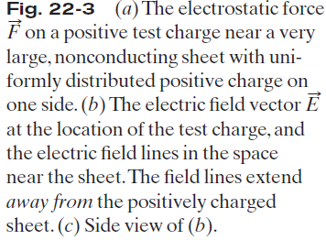
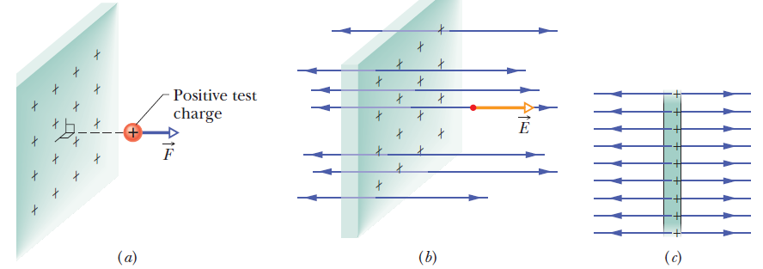
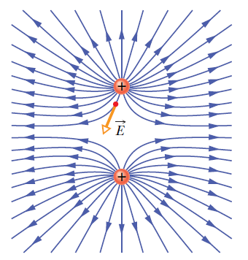
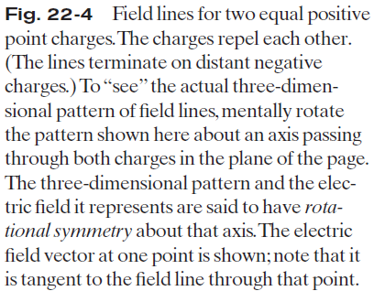

Slide 16
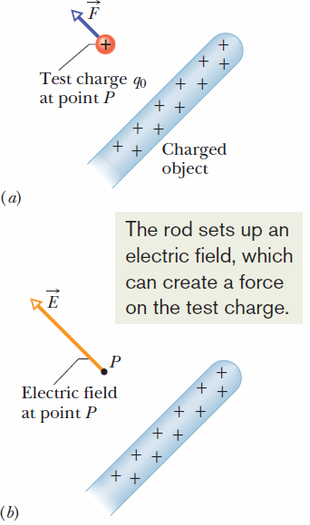

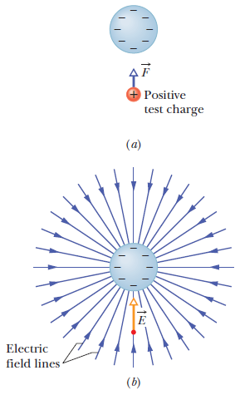
Preliminary Summary
How does charged particle 2 push on charged particle 1 when they have no contact?
A positive test charge q₀ placed at point P near a charged object. An electrostatic force F acts on the test charge
The electric field E at point P produced by charged object
SIMPLIFIED

Slide 17


3. The Electric Field due to a Point Charge:
To find the electric field due to a point charge q (or charged particle) at any point a distance r from the point charge, we put a positive test charge q₀ at that point.
The direction of E is directly away from the point charge if q is positive, and directly toward the point charge if q is negative. The electric field vector is:
(*)

Slide 18

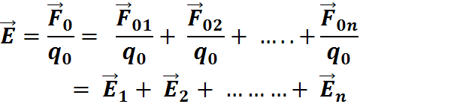
The Electric Field due to
a Point Charge(cont.)

Slide 19
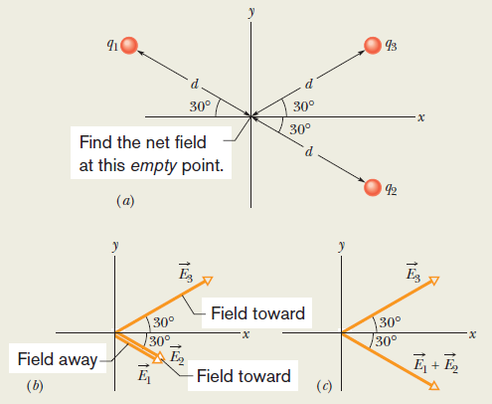




The Electric Field due to
a Point Charge(cont.)
q1 = +2Q, q2= -2Q, and q3= -4Q
(E₁ +E₂)y = (E₃)y, then

Slide 20
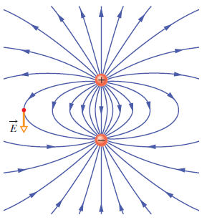
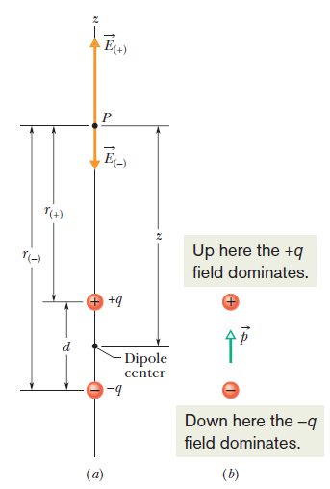
Electric Dipole
4. The Electric Field due to an Electric Dipole:
(a) An electric dipole. The electric Field vectors E₍₊₎ and E₍₋₎ at point P on the dipole axis result from the dipole’s two charges.
Point P is at distance r₍₊₎ and r₍₋₎ from the individual charges that make up the dipole.
(b) The dipole moment p of the dipole points from the negative charge to the positive charge

Slide 21


The Electric Field due to an Electric Dipole(cont.)
The product q_{d}, which involves the two intrinsic properties q and d of the dipole, is the magnitude p of a vector quantity known as the electric dipole moment of the dipole.
From symmetry, the electric field E at point P and also the fields E₊ and E₋ due to the separate charges that make up the dipole must lie along the dipole axis, which we have taken to be a z axis.
From the superposition principle for electric fields, the magnitude E of the electric field at P is
the magnitude p of a vector quantity known as the electric dipole moment

Slide 22
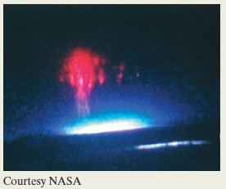
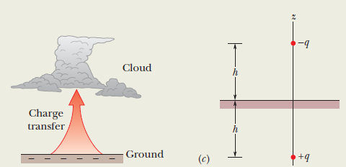


a vertical electric dipole that has charge -q at cloud height h and charge +q at below-ground depth h. If q = 200 C and h = 6.0 km, what is the magnitude of the dipole’s electric field at altitude z1 = 30 km somewhat
above the clouds and altitude z2 = 60 km somewhat above the stratosphere?

Slide 23



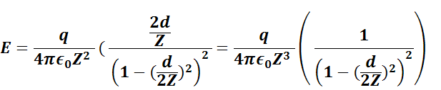

The Electric Field due to an Electric Dipole(cont.)

Slide 24
Gauss’ Law
Gauss’ law relates the electric fields at points on a (closed) Gaussian surface to the net charge enclosed by that surface.
Gauss’ law considers a hypothetical (imaginary) closed surface enclosing the charge distribution.
This Gaussian surface, as it is called, can have any shape, but the shape that minimizes our calculations of the electric field is one that mimics the symmetry of the charge distribution.

Slide 25
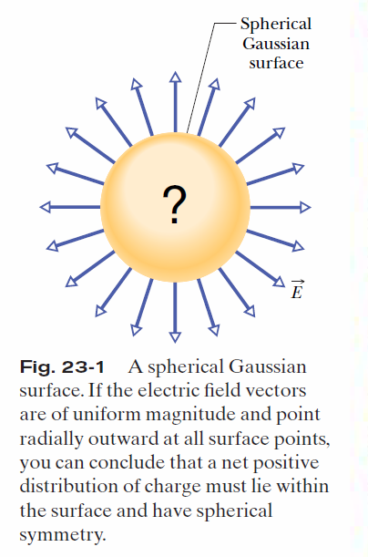
Gauss’ law relates the electric fields at points on a (closed) Gaussian surface to the net charge enclosed by that surface.
Gauss’ law considers a hypothetical (imaginary) closed surface enclosing the charge distribution.
This Gaussian surface, as it is called, can have any shape, but the shape that minimizes our calculations of
the electric field is one that mimics the symmetry of the charge distribution.

Slide 26
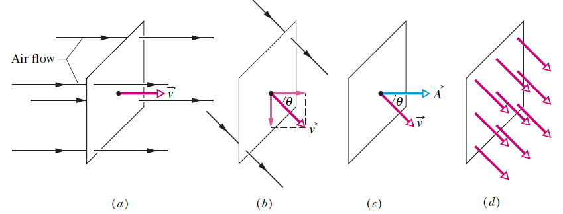

Electric Flux
Fig. 1. (a) A uniform airstream of velocity is perpendicular to the plane of a square loop of area A.(b) The component of perpendicular to the plane of the loop is vcosθ, where θ is the angle between V and a normal to the plane. (c) The area vector A is perpendicular to the plane of the loop and makes an angle θ with v. (d) The velocity field intercepted by the area of the loop. The rate of volume flow through the loop is
This rate of flow through an area is an example of a flux—a volume flux in this situation.

Slide 27


Electric Flux (cont.)
The electric field vectors E and the area vectors ΔA for three representative squares, marked 1, 2, and 3, are shown.
The exact definition of the flux of the electric field through a closed surface is found by allowing the area of the squares shown in Fig. 2 to become smaller and
smaller, approaching a differential limit dA. The area vectors then approach a differential limit dA. The sum of
Equation then becomes an integral:

Slide 28
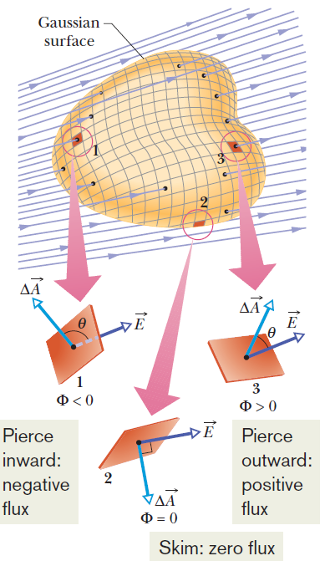
Electric Flux (cont.)
The electric flux through a Gaussian surface is proportional to the net number of electric field lines passing through that surface.
Fig. 2. A Gaussian surface of arbitrary shape immersed in an electric field. The surface is divided into small squares of area ΔA.

Slide 29
Gauss’s Law(cont)
Gaussian Surface
Gauss’s Law and Coulomb’s Law:
Fig. 3. shows a positive point charge q, around which a concentric spherical Gaussian surface of radius r is drawn. Divide this surface into differential areas dA.
The area vector dA at any point is perpendicular to the surface and directed outward from the interior.
From the symmetry of the situation, at any point the electric field, E, is also perpendicular to the surface and directed outward from the interior.
r
E
+
dA
q
A spherical Gaussian
surface centered on a point charge q

Slide 30


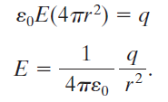
Gauss’s Law(cont)
This is exactly what Coulomb’s law yielded.

Slide 32
These slides have been adapted from
Halliday D.; Resnick R. and Walker J. (2018). Fundamentals Of Physics ,Extended,
11th , John Wiley & SONS Inc, New York, ISBN: 9781119306856
Chapter 21
Bina Nusantara

